Slide 1
JavaScript: Control Structure

Slide 2
Algorithms
Actions to be executed
Order in which the actions are to be executed
Pseudocode: informal representation of an algorithm
  If prepared carefully, pseudocode statements can be converted in to actual programming code in a fairly straightforward fashion

Slide 3
Control Structures
Elements of code that define an individual action
Like most programming languages, JavaScript has three control structures:
  Sequence structure
    Any individual non-selection and non-repetition statement falls into this category: individual calculation, input or output statement, type conversion, etc.
  Selection structure: three in JavaScript
    if
    if…else
    switch
  Repetition structure: four in JavaScript
    while
    do…while
    for
    for…in

Slide 4
if Selection Statement
Single-entry/single-exit structure
Indicate action only when the condition evaluates to true. No action for false
grade >= 60
true
print “Passed”
false

Slide 5
if…else Selection Statement
Indicate different actions to be perform when condition is true or false
false
grade >= 60
true
print “Failed”
print “Passed”
Conditional operator (?:) (see page 217), closely related to if…else
  JavaScript’s only so called “ternary” operator
    Three operands
    Forms a conditional expression

Slide 6
Nested if…else Selection Statement
When we have one decision criterion but with multiple and mutually exclusive range of values
  If student = “Senior” …
  Else if student = “Junior” …
  Else if student = “Sophomore” …
  Else …
  Switch clause can be used instead
When we have more than one decision criterion
  for example when making decisions based on combined values of variable “age” and “income”:
  Logic errors vs. syntax errors
  Can be simplified by using logical AND (&&) , OR (||) operators
    In class example

Slide 7
while Repetition Statement
Repetition structure (loop)
  Repeat action while some condition remains true
true
product <=
1000
product =
2
* product
false

Slide 8
Formulating Algorithms:
Example 1 (Counter-Controlled Repetition)
Counter-controlled repetition
  Counter
    Control the number of times a set of statements executes
  Definite repetition

Slide 9
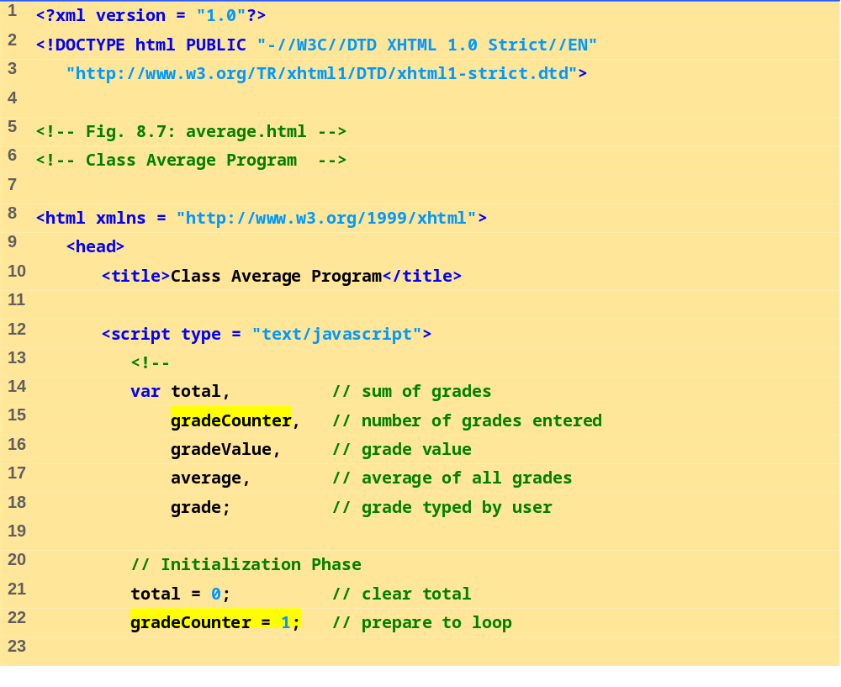
average.html
(1 of 3)

Slide 10
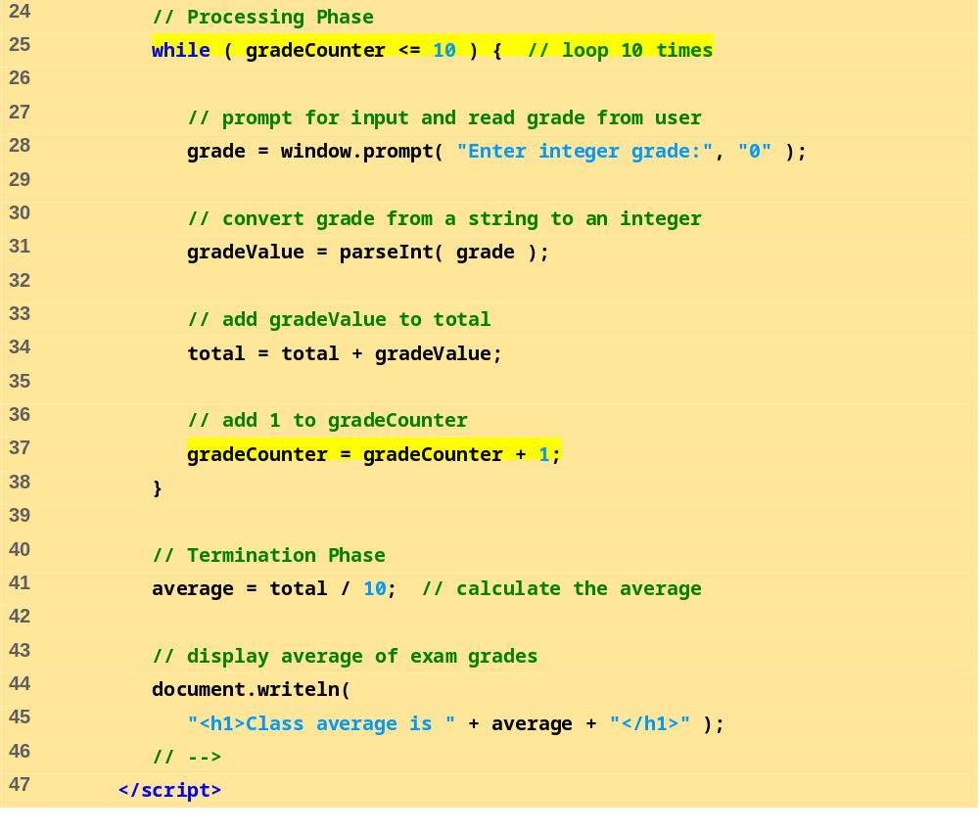
average.html
(2 of 3)

Slide 11
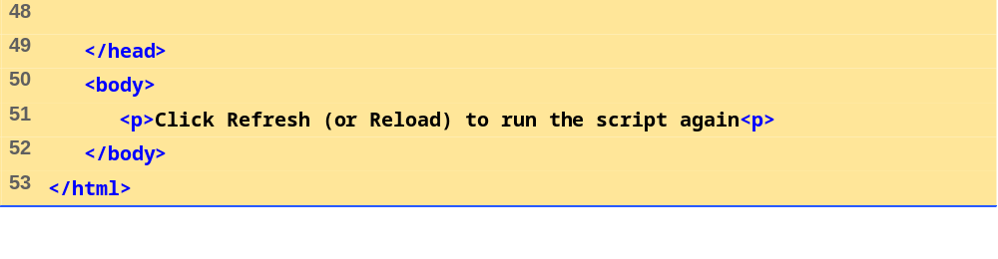
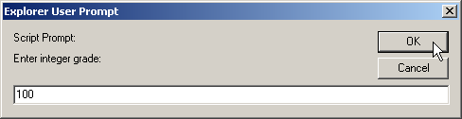
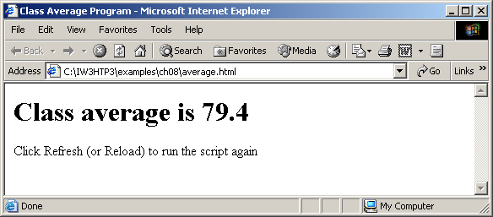
average.html
(3 of 3)

Slide 12
Example 2 (Sentinel-Controlled Repetition)
Indefinite repetition
  Sentinel value indicates the end of data entry: should be out of range of acceptable values

Slide 13
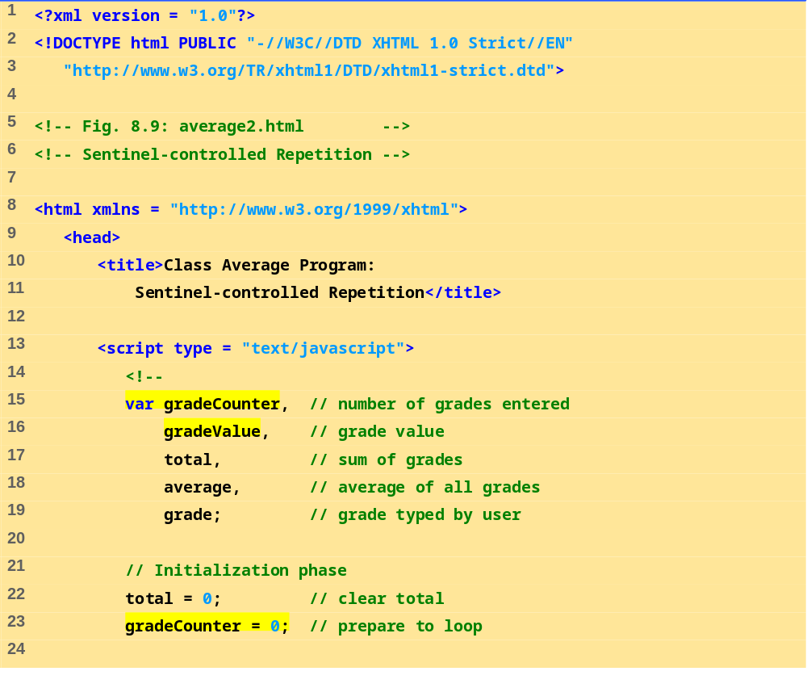
average2.html
(1 of 3)

Slide 14
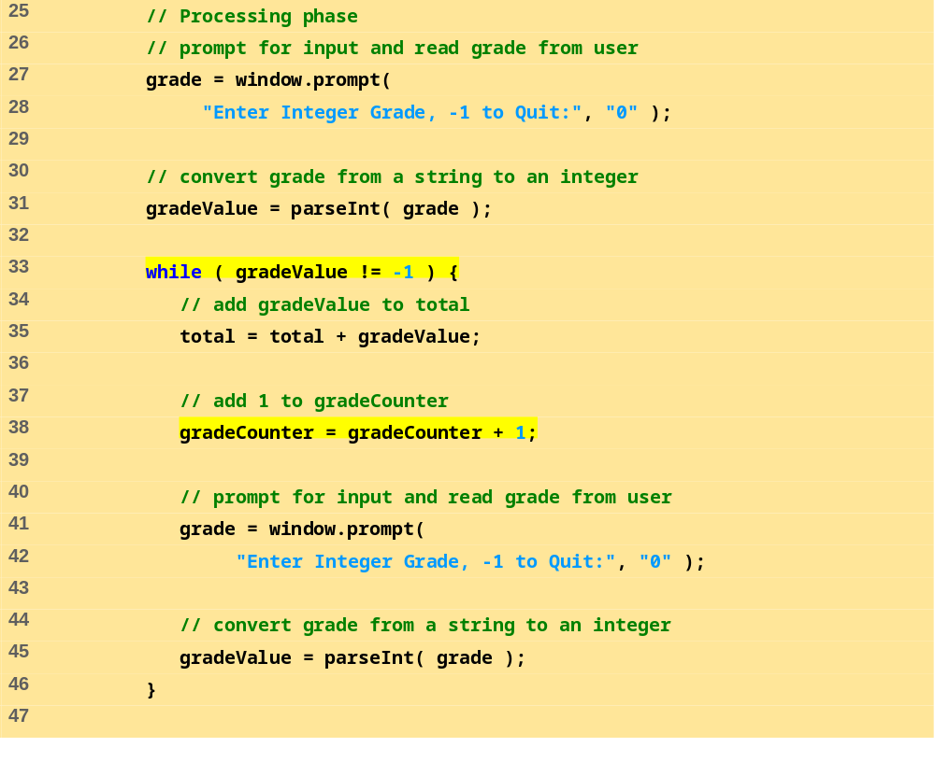
average2.html
(2 of 3)

Slide 15
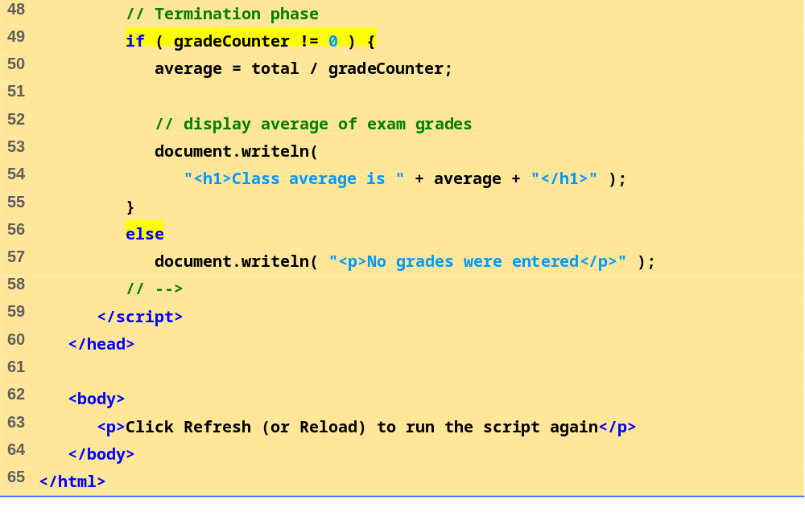
average2.html
(3 of 3)

Slide 16
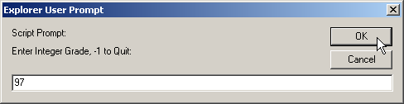
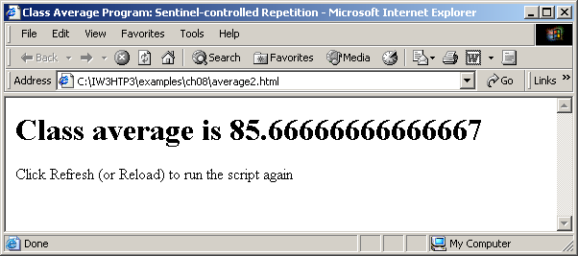

Slide 17
Example 3 (Nested Control Structures)
Consider problem
Make observations
Top-down, stepwise refinement

Slide 18
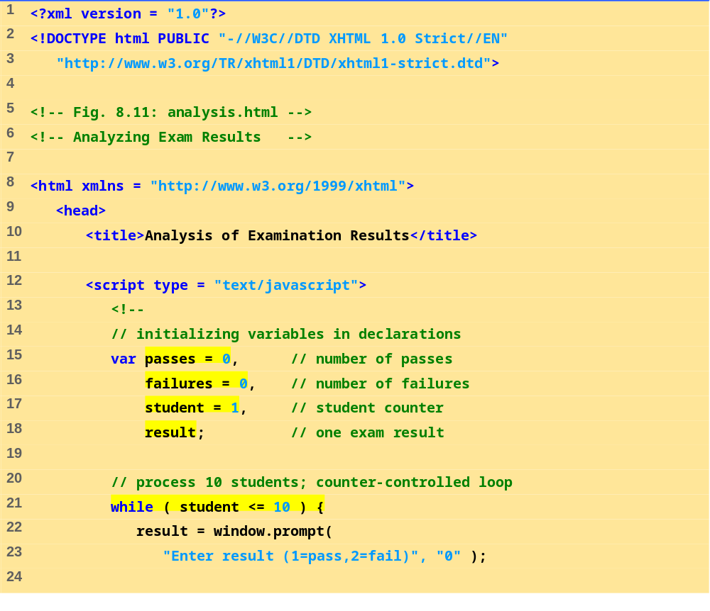
analysis.html
(1 of 2)

Slide 19
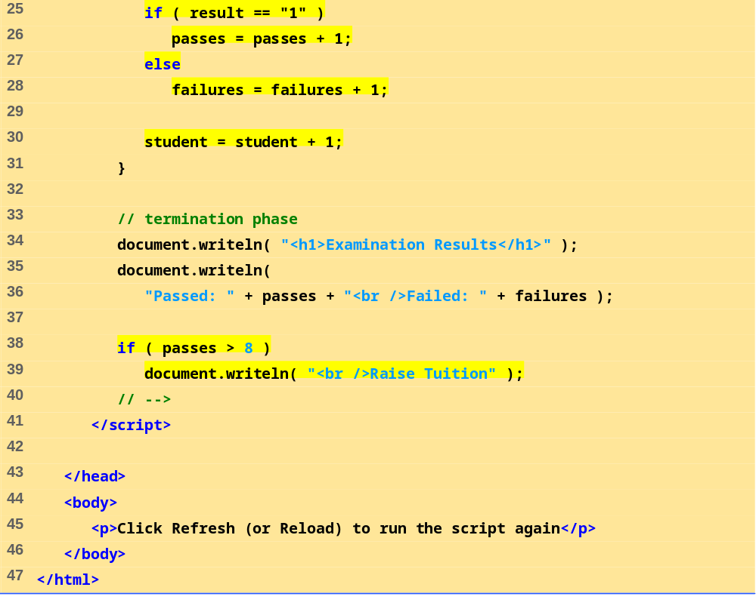
analysis.html
(2 of 2)

Slide 20
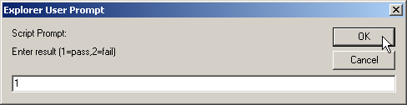
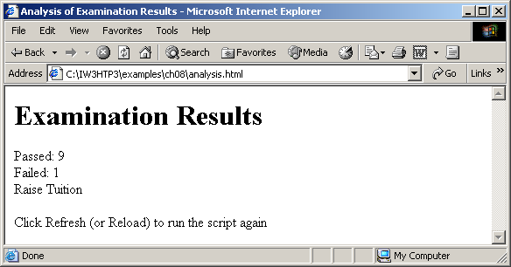

Slide 21
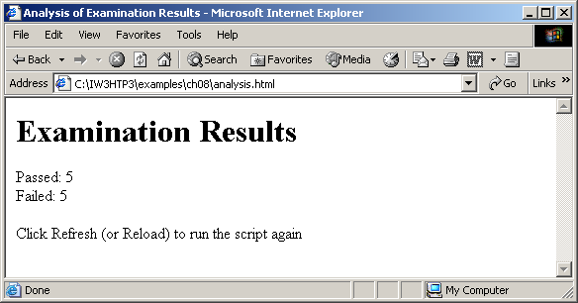

Slide 22
Assignment Operators
Compound assignment operators
  Abbreviate assignment expressions

Slide 23
8.13 Note on Data Types
Loosely typed
  Automatically converts between values of different types

